Slide 1
MULTI-CUT REBAR(9)
Advisor : Prof. K.C.Chang
Presenters : You-Ran Nai

Slide 2
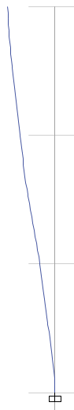
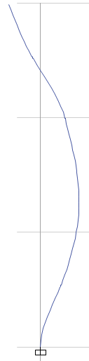
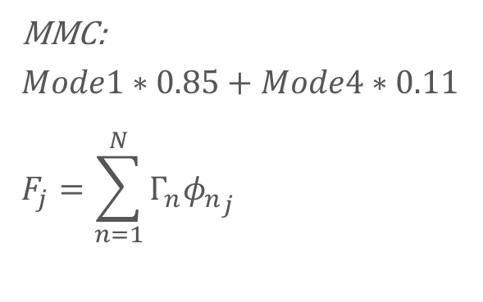
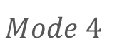
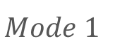
Mode Pushover
0.261835
$$Mode 1$$
$$Mode 4$$
MMC:
$$Mode1∗0.85+Mode4∗0.11$$
$$F_{j}=\sum_{n=1}^{N}{Γ_{n}{φ_{n}}_{j}}$$
1316kN
140mm
0.171129
1627kN
50mm
558kN
109mm
0.066064
Notes:
Pushover mode 1, 4, MMC

Slide 3


Slide 4
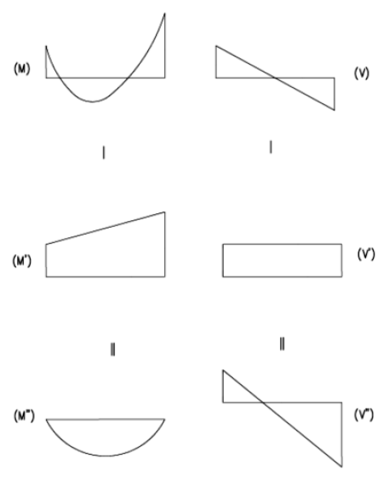
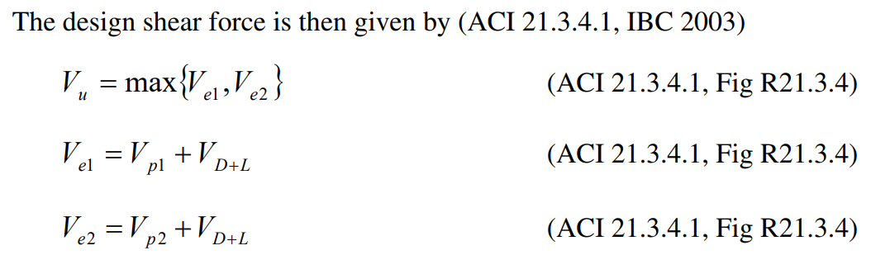
Sway Special

Slide 5
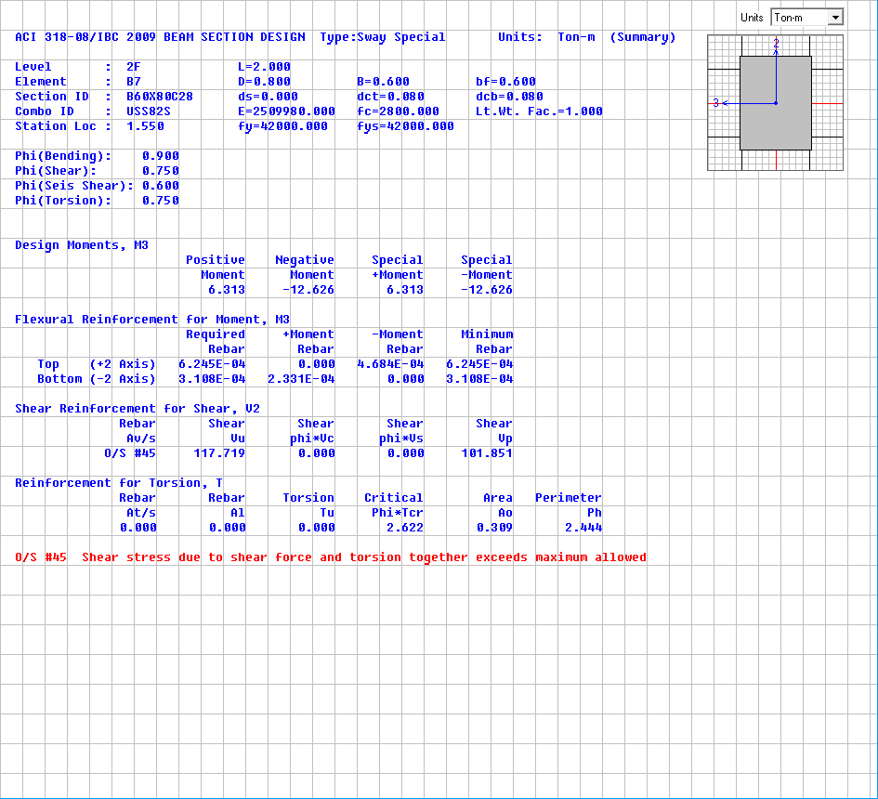
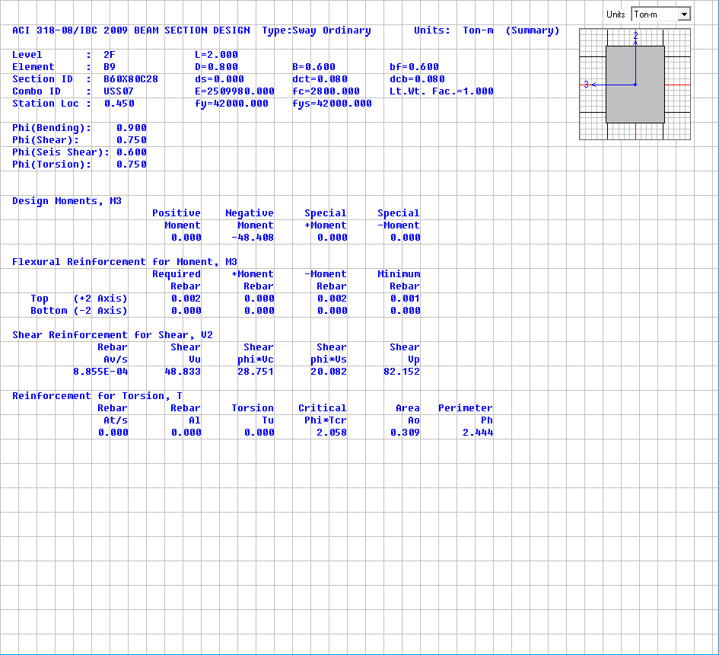
Shear Design
Sway Special
Consider Vp
Sway Ordinary
No Consider Vp
Vp=101.851t
Vu=117.719t
Vp=82.152t
Vu=48.833t

Slide 6
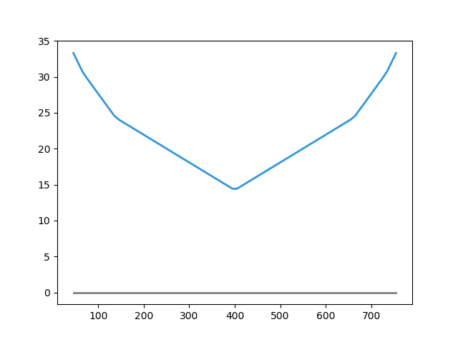
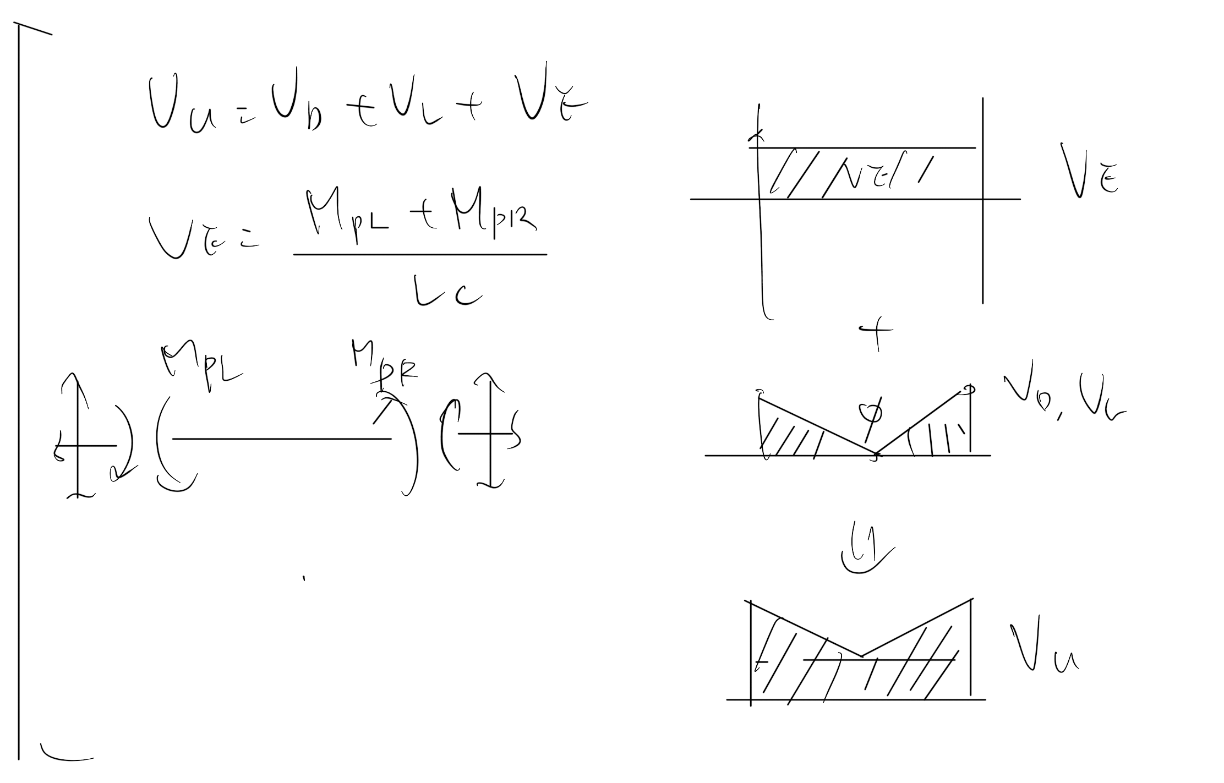
Shear Design
Easbs Shear Rebar Area

Slide 7
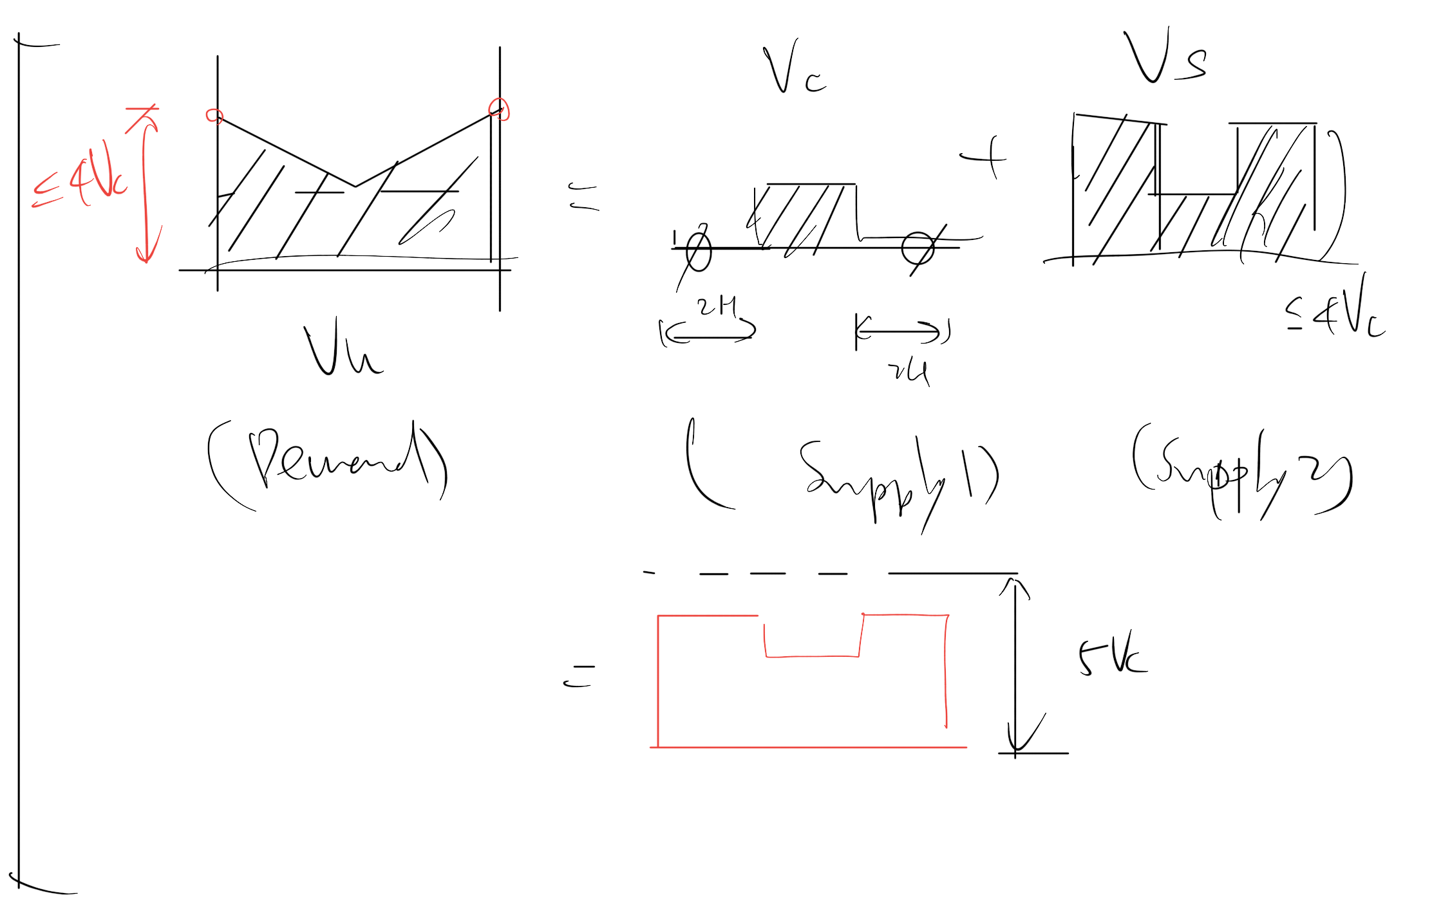

Slide 8
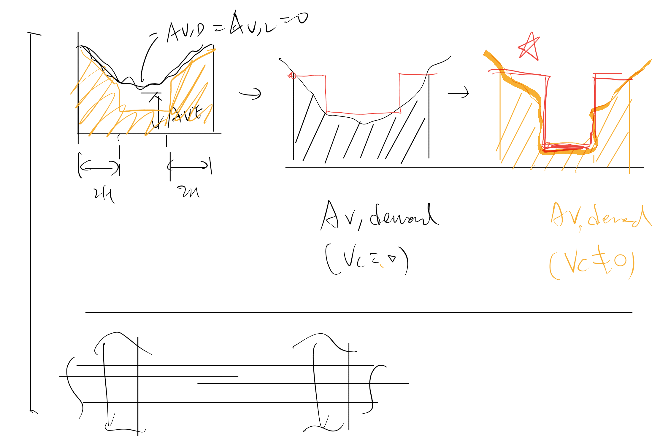

Slide 9
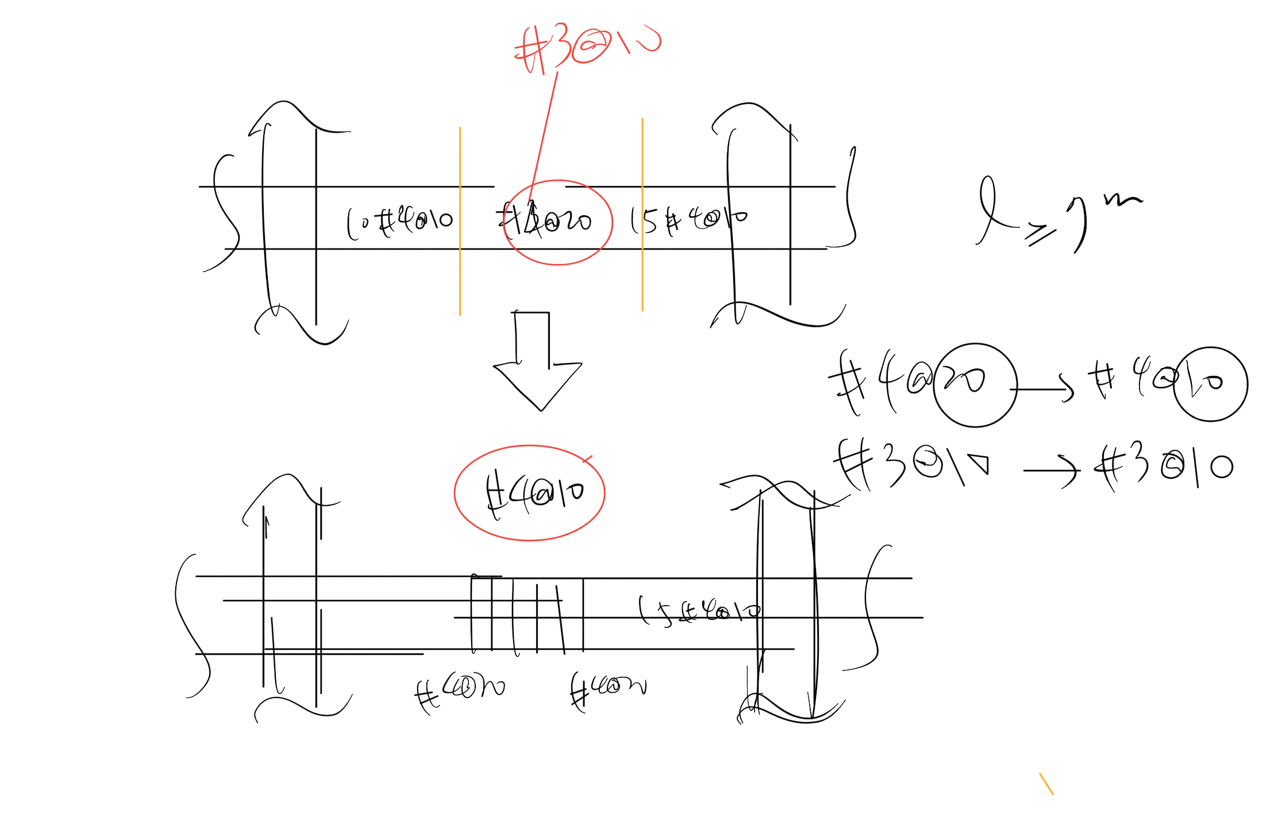

Slide 10
5 MULTI CUT
Pattern
…

Slide 11
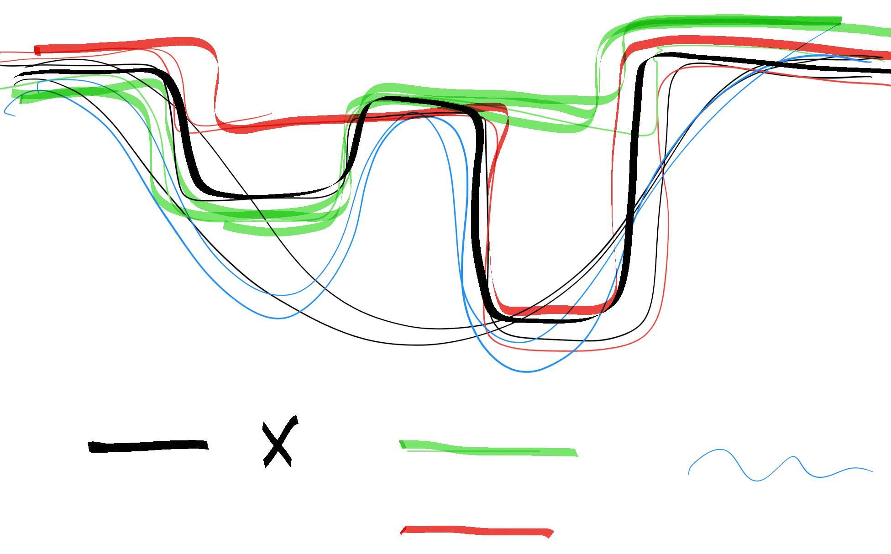
Five
Four
Demand

Slide 12
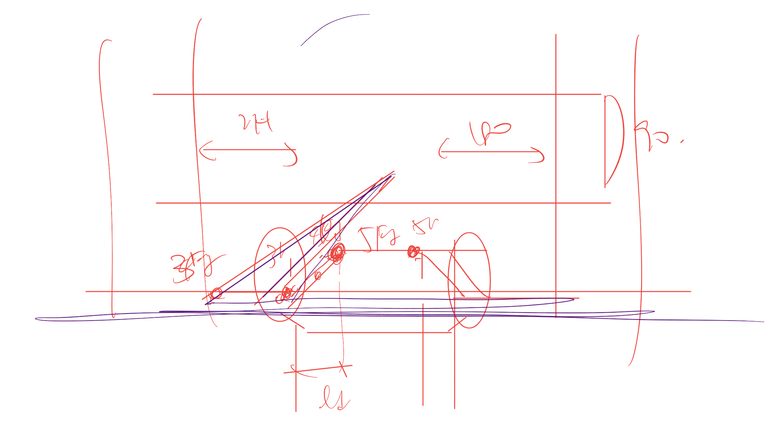
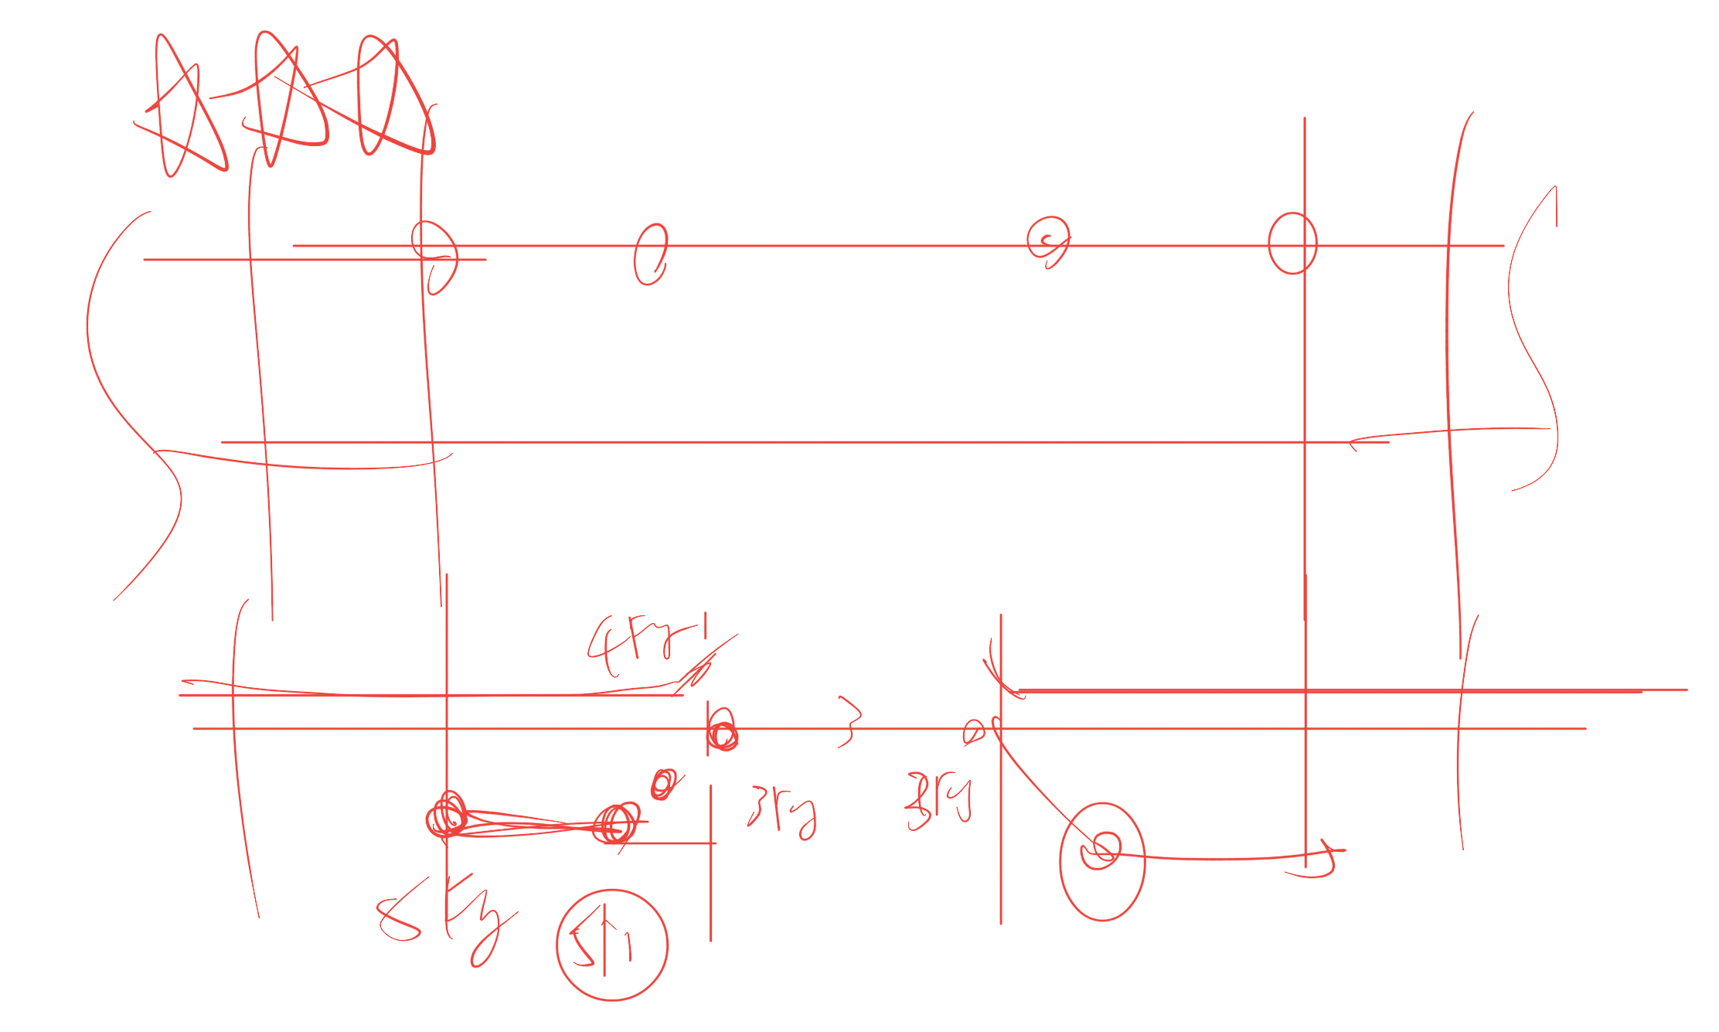
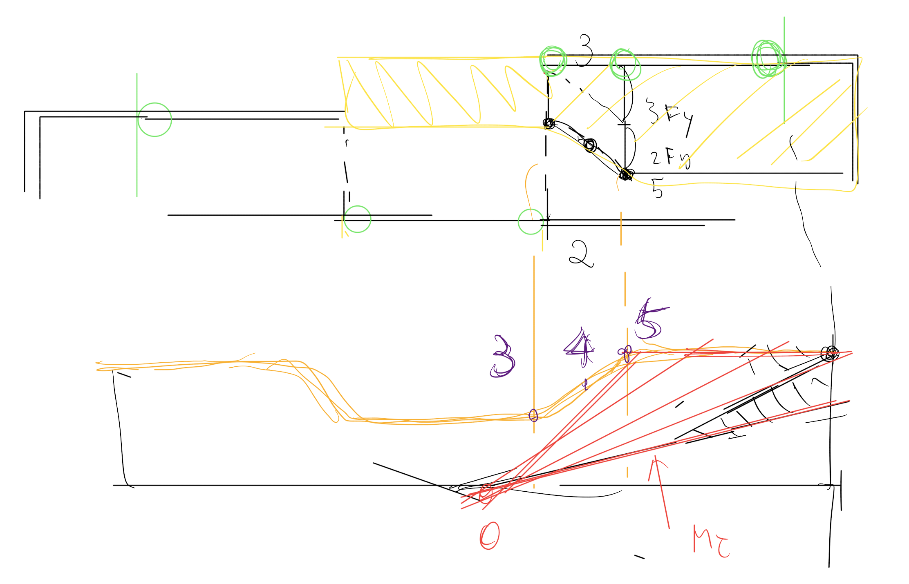
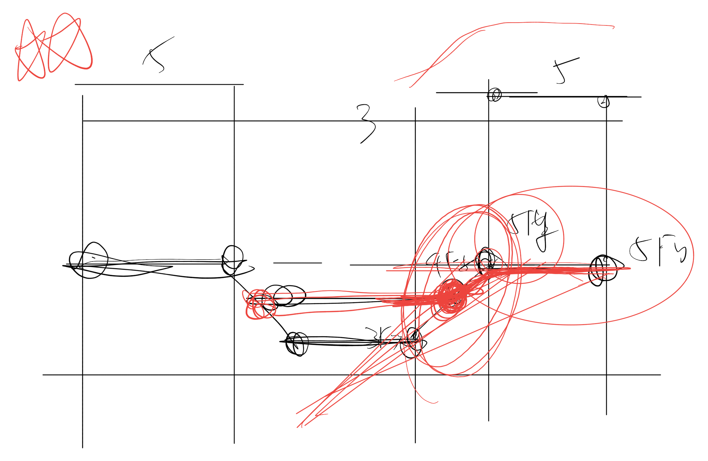

Slide 13
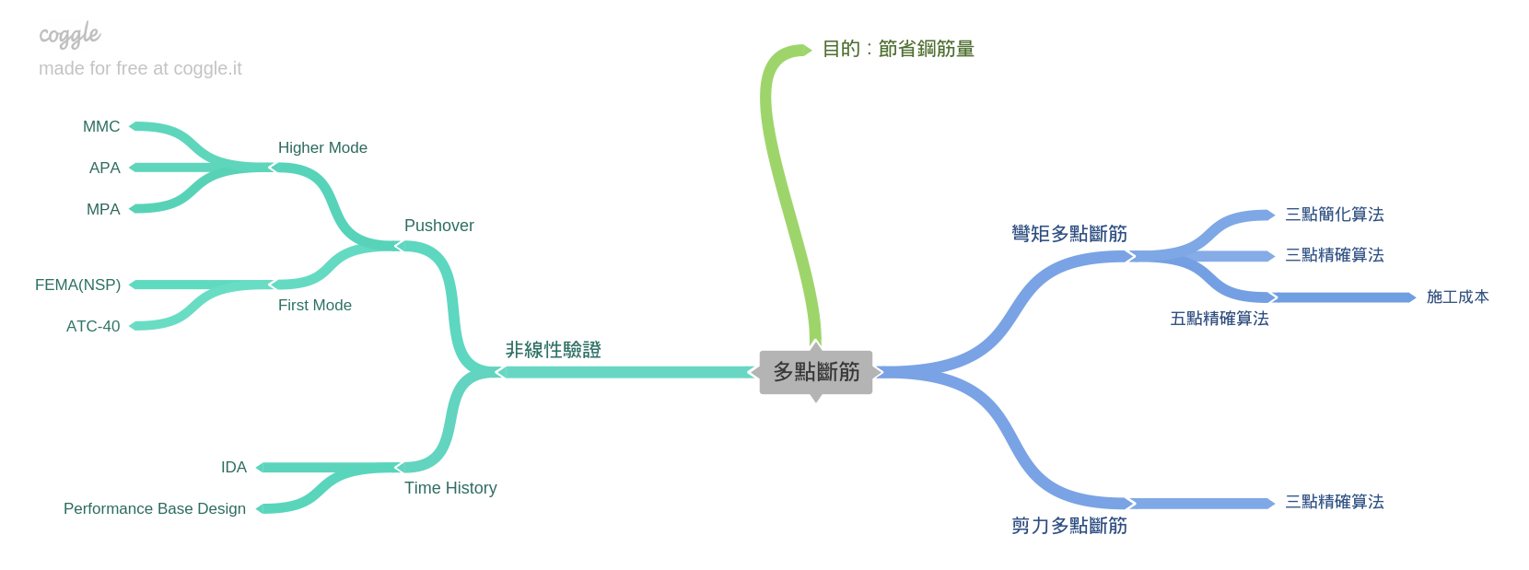
Roadmap

Slide 14
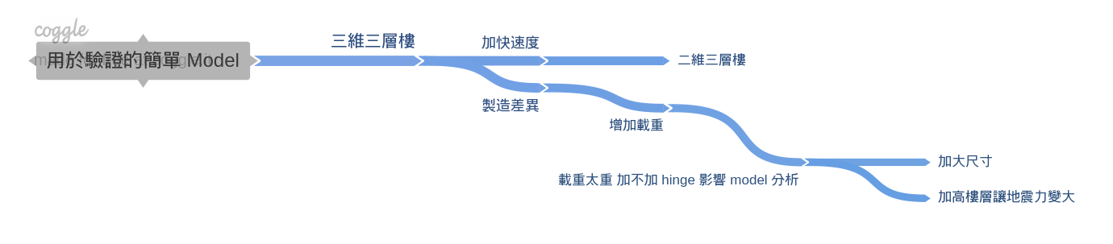
Nonlinear
Simple Model

Slide 15
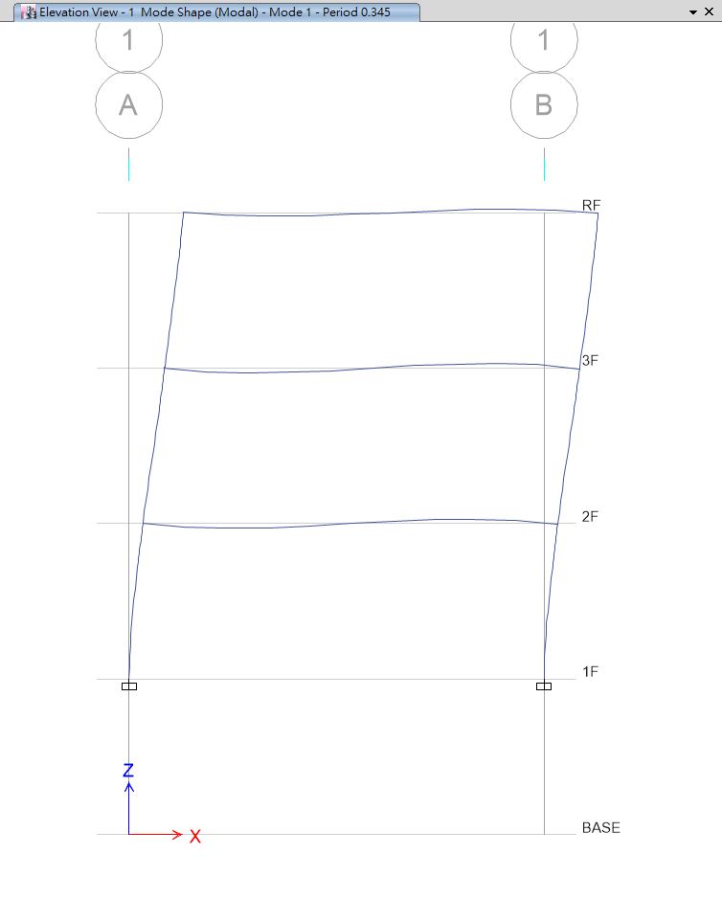
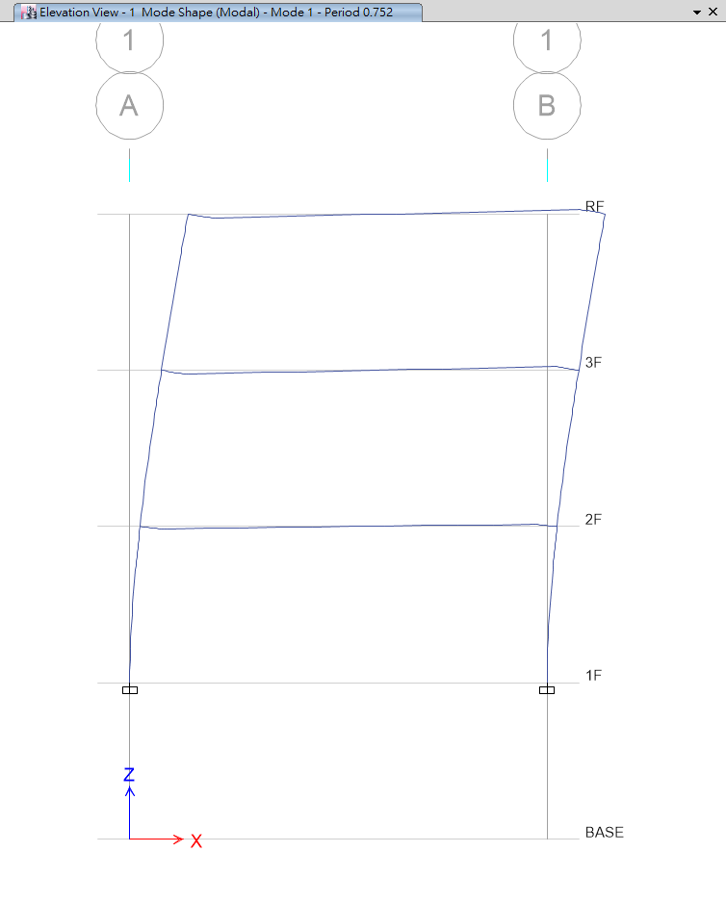
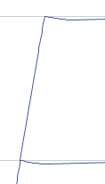
T=0.345
T=0.752
No Nonlinear Beam Hinge
Nonlinear Beam Hinge

Slide 16
Nonlinear
Simple Model

Slide 17
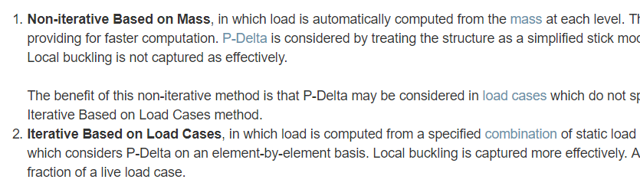
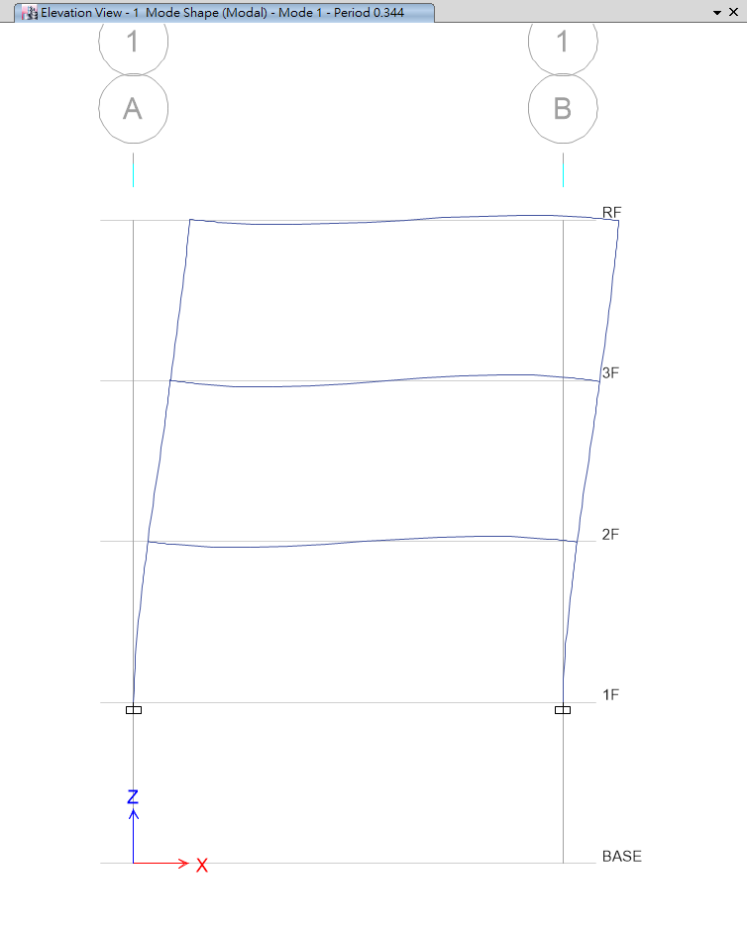
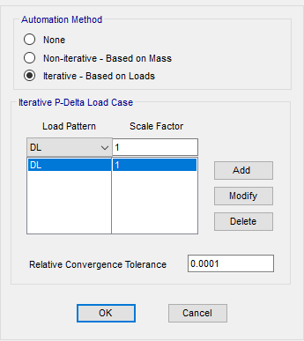
P-Delta
Local Buckling

Slide 21
Roadmap
Next
人工斷筋
Now
03/2016
Benchmark IDA
開發程式

